Slide 1
Predicting Neighborhood Safety Level
Exploratory Data Analysis & kNN Classification
Hongli (Bob) Zhao, Gary Lin, Meilong Zhang

Slide 2
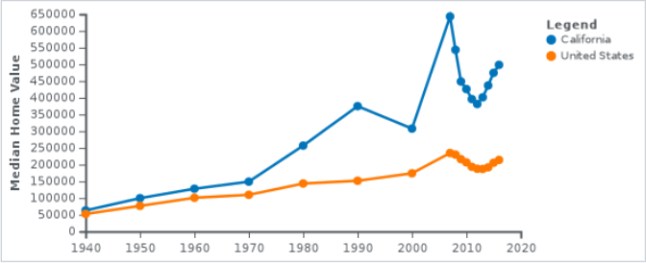
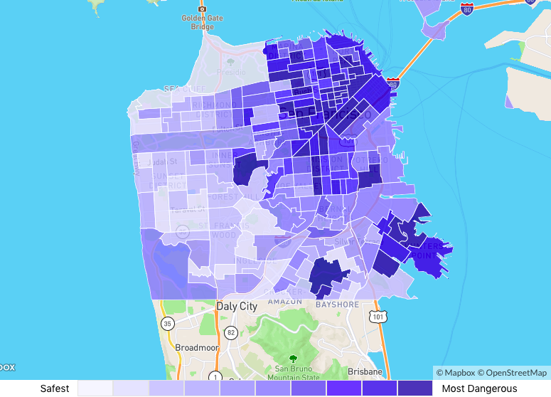
Project Formation & Outline
“Building a Better Bay Area”: Affordable housing crisis in California began since 1970. By 2017, median home price in the Bay Area rose to 2.5 times higher than that of the country.
Why our model may be of interest to you:
There are many crime maps available from public sources, however, they do not provide succinct detailed information.
We aim to provide more detailed information regarding the home selection process.
Notes:
What our model is doing more?
The publicly avaible maps only mark the “danger level” by the total number of crime committed, however, that would not be optimally informative in making better decisions for homes.
For instance, minor offenses such as passing bad checks, littering, bribery would NOT be as informative in terms of the overall safety of homes in this area.
We aim to take a quantitative approach in our prediction and classification. By assigning each neighborhood an aggregated “safety” level, we are able to make better predictions in regards to statistically how safe the neighborhood is, based on the different weights and factors placed on each category, we divide them in

Slide 3
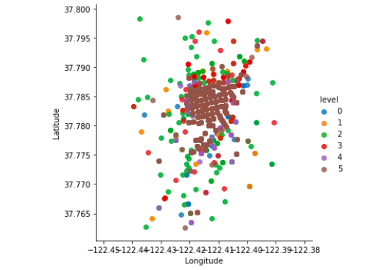
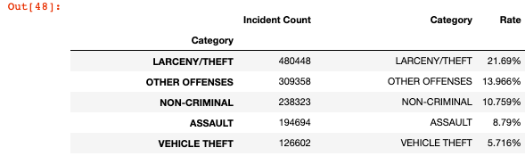
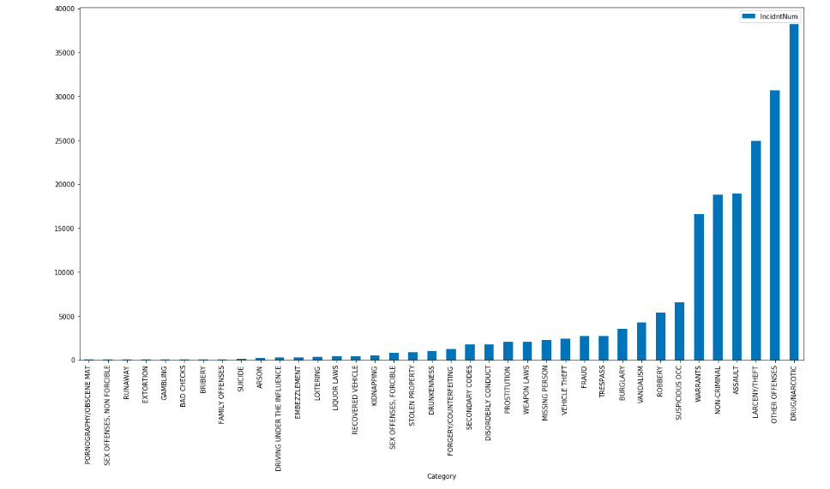
The Approach
Dataset:
We are performing analysis using official police records obtained from DataSF (SF Open Data).
Steps:
Exploratory data analysis and visualization
Grouping and Assignment of “danger level” bins
K-Nearest Neighbor classification to predict the danger level of a new location

Slide 4
Current status
What Challenges are We Facing?
1. Inefficiency in processing large datasets (~2 million) of 14 years
2. “Locality” of our classification
3. Proximity analysis is relatively restricted by dimension of attributes

Slide 5
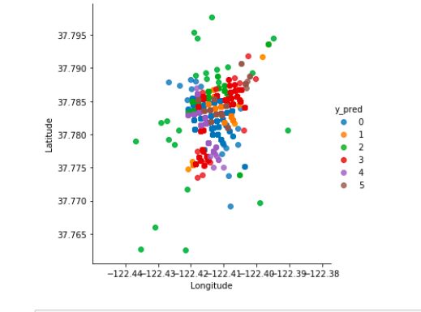
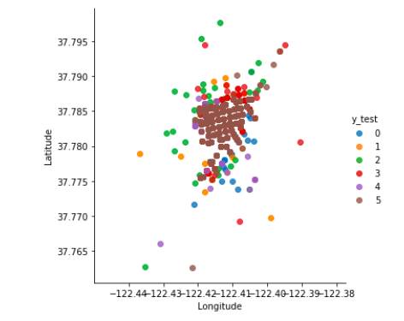
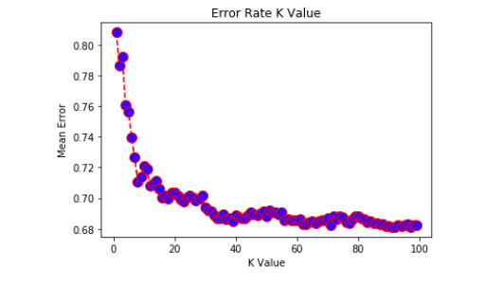
Modeling the Data
We labeled all categories of crime into 5 levels of magnitude and use kNN classification.

Slide 6
Going Forward
Concisely, we would like to answer two questions
What are other factors that can be attributed to a neighborhood’s safety level?
Can we make responsible price predictions using our model?

Slide 7
Our Solution -- What does success look like to us?
Example Statement: By assigning each neighborhood in the Bay Area a safety / danger level, we find that safety is positively / negatively correlated with home prices, thus we are able to help homeowners make more informed decisions.

Slide 8
Thank you !
Notes:
Any other questions? Thank you for being here today!

